Slide 1


Final Presentation
TEMPORAL VARIATION OF CRIME IN
TARTU AND TARTU MUNICIPALITY
Planning Project

Slide 2


Introduction
Crime is one of the major factors which influences on people decision to change place of iving and, as a result, determines the rise and decline of neighbourhoods.
The used methods and techniques to study crime are limited to analysis of behavioural patterns of offenders and different demographic characteristics such as sex, age, race or socioeconomic status
Studying the crime with reference to its temporal distribution is important because information about the occurrence of crime is one of the most crucial tools in combating crime
What differences occur in Tartu and Tartu municipality regarding crime temporal patterns?
How does time affects the number of crimes?
How times affect spatial distribution of crime?

Slide 3

Basis for the sketch plans to compile a spatial plan.
Proposing measures for crime prevention.
STEPS
Results
Crime variation in Tartu city and Tartu municipality based on Time dimension
Data and Methods
The data is available as a table in CSV format from Police and Border Guard Board of Estonia
Poisson-based regression analysis
Theoretical overview
Theoretical background for this study providing geography of crime theories as a discipline of human geography

Slide 4


Overview Data/Methods Results Discussion
Temporal perspective of crime
Routine activity theory
Changes in the places in which people tend to spend time and the pathways they travel to. If routine activities change at different times, but in a patterned way, then spatial patterns of crime will change as well
Place-based strategy is not enough for crime mitigation activities.
It is important to know where crime patterns cluster in both space and time.
Montolioa
2016
Catlett et al.
2019
Oliveira, et. Al
2018
Temperature-aggression theory
Melgarejo
et al. 2018
Bediroglu et
al. (2018)
Yar et al.
2016
Temperature/heat which can cause irritation. Weather gets hot and people get mad more easily, this leads to a loss of tempers.
Andresen et.
al 2013
Melo 2018
Vandeviver et al.
2017

Slide 5
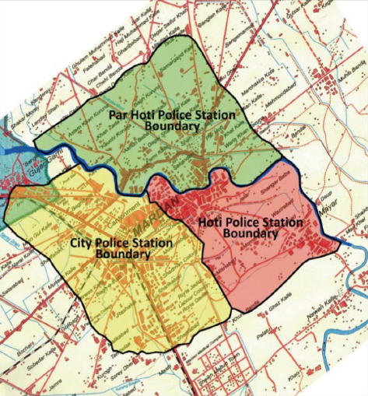
Overview Data/Methods Results Discussion
Temporal patterns of crime
Seasonal distribution of crimes in Mardan City, Pakistan
(Source: Yar et al. 2016)
Clear seasonal patterns in crime frequency in different geographical regions.
Crime numbers increase during the warm months and falls in the winter months
Montolioa
2016
47%
Crimes during May-Sep
Crimes during Oct-Feb
Crimes during March-April
Catlett et al.
2019
Oliveira, et. Al
2018
33%
Melgarejo
et al. 2018
Bediroglu et
al. (2018)
Yar et al.
2016
Andresen et.
al 2013
Melo 2018
20%
Vandeviver et al.
2017
Notes:
Yar et al. (2016)
47% of total crimes were committed from May-September (summer) followed by 33% in winter and the rest 20% in spring (March-April) during the year 2009 in Pakistan.
Temperature/heat can cause irritation which made people commit crime.

Slide 6
Overview Data/Methods Results Discussion
Weekly crime evolution in Barcelona, Based on detailed crime events dataset 2007 – 2011
(Source: Montolioa et. al 2016)
Temporal patterns of crime
Clear weekly patterns in crime frequency in different geographical regions.
Crime numbers increase during the weekends and falls in the weekdays
Montolioa
2016
Catlett et al.
2019
Oliveira, et. Al
2018
Melgarejo
et al. 2018
Bediroglu et
al. (2018)
Yar et al.
2016
Andresen et.
al 2013
Melo 2018
Vandeviver et al.
2017

Slide 7

Overview Data/Methods Results Discussion
Overview of used crime data
Map of source data
Tartu city and
Tartu municipality
From 2014 to
2018
Police and Border Guard Board of Estonia
CSV Format
Crime Data

Slide 8





Overview Data/Methods Results Discussion
Used methods of analysis
Microsoft Excel
RStudio
The used categories are years, months, days of the week, hours of the day and types of crime. All categorization was done separately for Tartu city and Tartu municipality.
Poisson regression analysis was conducted using RStudio.
All the data preparation steps on initial crime events table are processed by RStudio.
ArcGIS software
SPSS
Creating Models to summarize the understanding of the crime events trends in Tartu.
Same results as Rstudio.
Illustrate spatial distribution of crime events. Amount of crime events in each centroid was calculated for all data and different temporal categories.

Slide 9
Overview Data/Methods Results Discussion
Poisson - based regression method
- The odds a random event will occur during a particular time interval.
-Binominal distribution.
Form of nonlinear regression that uses maximum likelihood estimation.
Depends on one or more independent variables.
Independent variables
Year, season, day of the week and day interval.
Dependent variables
Crime events count

Slide 10
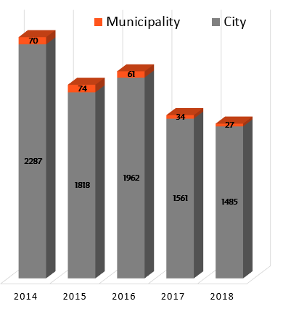
Types
Hours
Years
Days
Tartu city
1294
1227
1503
1139
Months
1243
1408
1299
Tartu municipality
2014 2015 2016 2017 2018

Slide 11
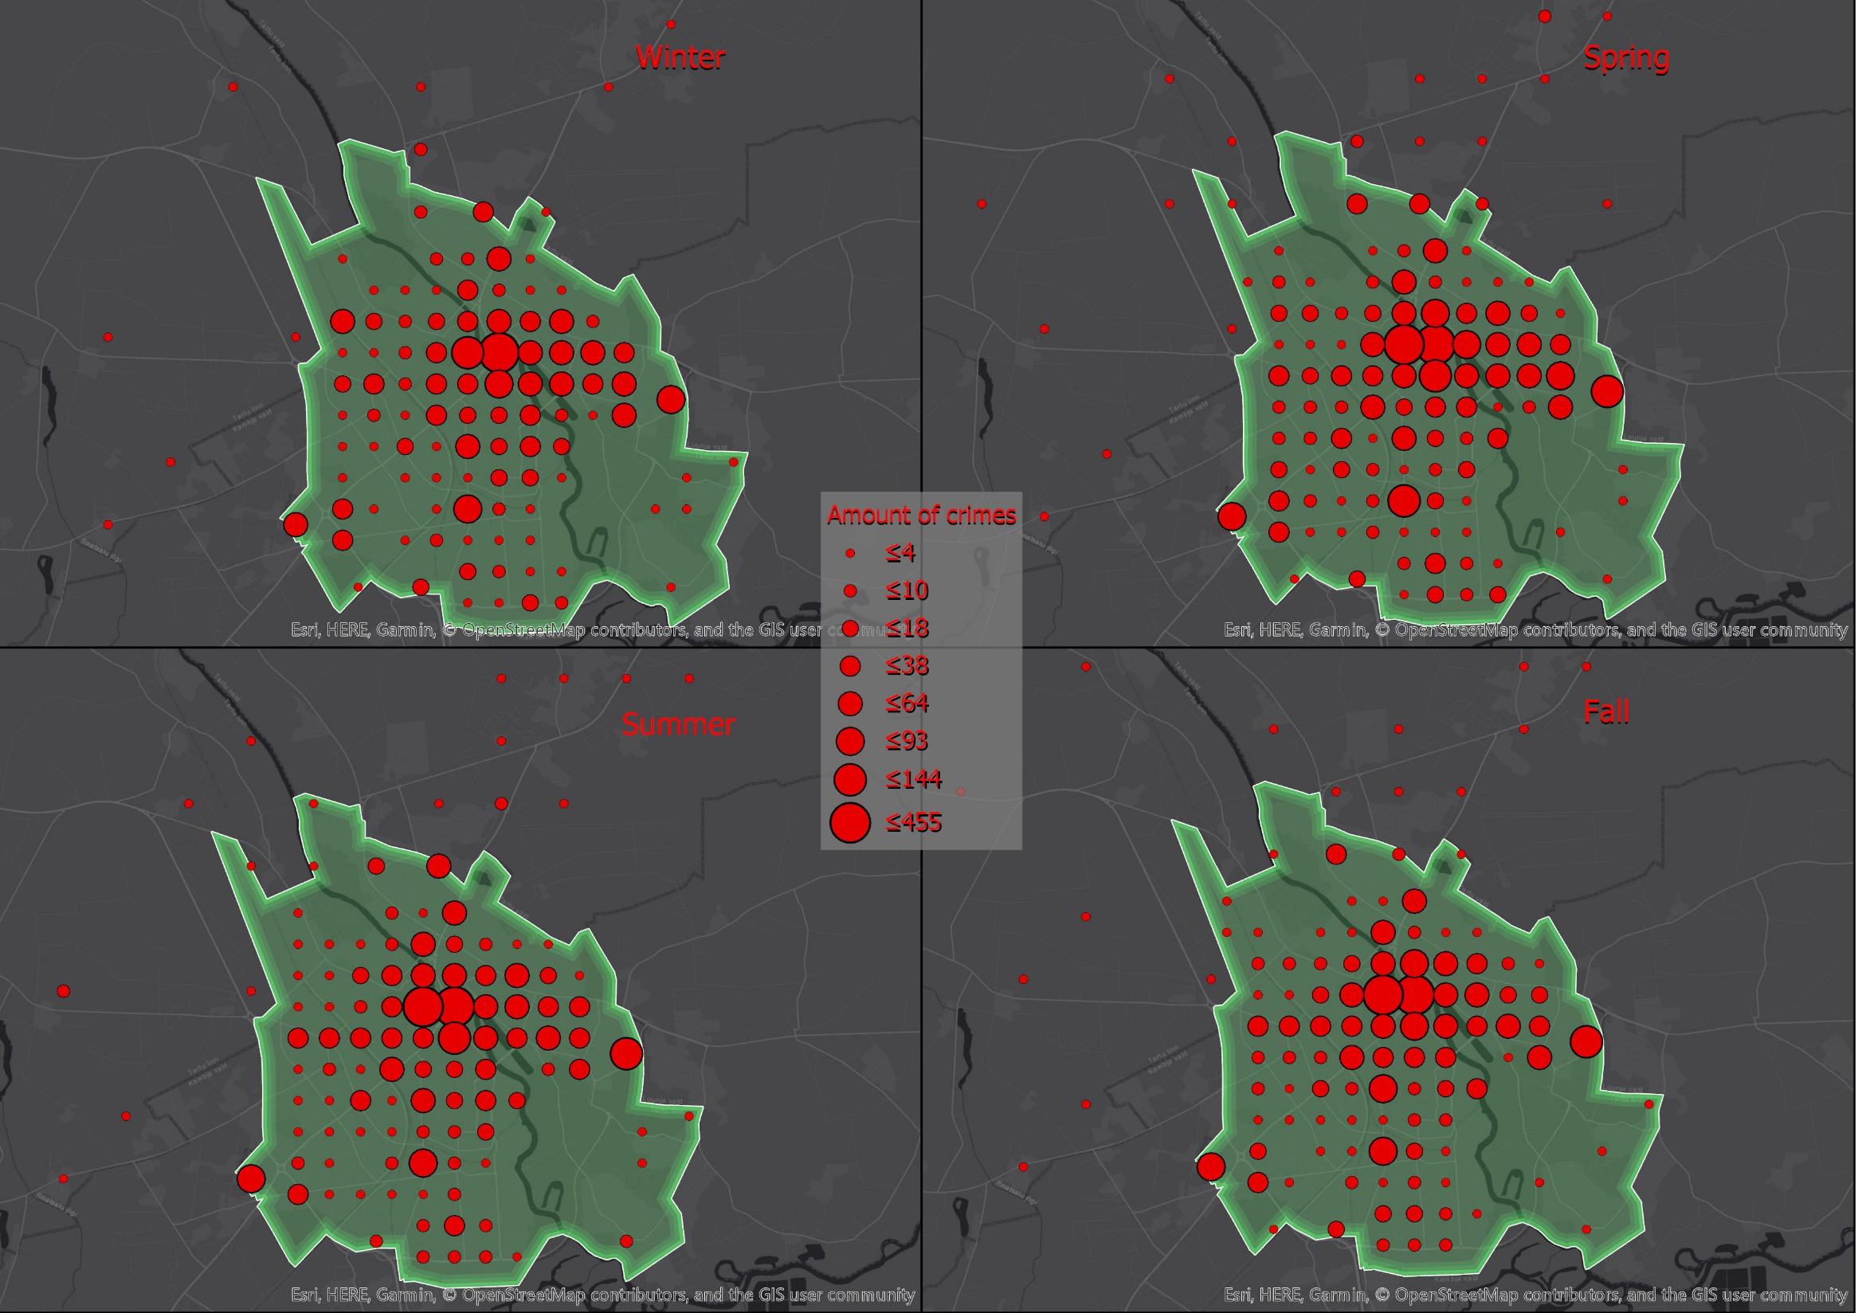
Winter
Spring
Summer
Fall

Slide 12
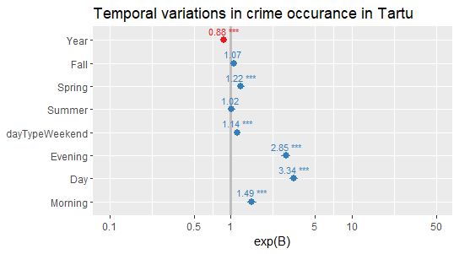
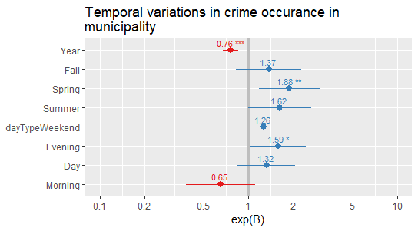
Tartu City
 | Tartu city |  | Tartu municipality
Parameter | P-value | ExpB (ci) | P-value | ExpB (ci)
Intercept | 0.000 | 2.01E+116 | 0.000 | 2.16E+239
Season
Fall | 0.063 | 1.067 | 0.220 | 1.371
Spring | 0.000 | 1.217 | 0.008 | 1.883
Summer | 0.617 | 1.018 | 0.052 | 1.619
Winter | . | 1 | . | 1
Day Interval
Day | 0.000 | 3.343 | 0.218 | 1.323
Evening | 0.000 | 2.855 | 0.034 | 1.587
Morning | 0.000 | 1.494 | 0.111 | 0.647
Night | . | 1 | . | 1
Day type
Weekday | . | 1 | . | 1
Weekend | 0.000 | 1.140 | 0.175 | 1.259
Year | 0.000 | 0.877 | 0.000 | 0.758
Tartu Municipality

Slide 13
Overview Data/Methods Results Discussion
Thefts are the most abundant type of crime in Tartu city.
The tendency of committing crime is increasing during the weekends in comparison with the weekdays, especially during Fridays and Saturdays, a great share of these crimes took place in public spaces, shops and streets.
The crime numbers reach the peak in spring, mostly in April and May, whilst, the lowest crime rates were recorded in winter (November, December).
After separating the day into four parts; morning, day, evening, night. In general, it turns out that more crimes are relatively occurring during the day.
The big majority of the total number of crimes belongs to Tartu city with a percentage of 97.16 % in front of 2.83% in Tartu Municipality.
Tartu municipality crime numbers are quite low and not precisely positioned (range of 500m) due to data normalization.
The rate of crimes in the study period has decreased significantly from 2357 (2014) to 1512 (2018).

Slide 14

Overview Data/Methods Results Discussion
On this level of the analysis, the outcomes are pretty satisfying, some errors were found in the data, but it is always a part of the process.
The the link between rising temperatures and crime almost
disappeared during the summer months in Tartu, notably in June, July and August.
People leave home more often on sunny days, which leads to an increase in interactions between people and thus an increase in the risk of interpersonal conflicts and opportunities for robberies and thefts.
These results of weekly distribution of crime go along with our literature overview (Montoliola et. al, 2016). Crime rates fall from weekdays; thereafter, they begin to rise reaching a peak on weekends.
The unveiled relationship between climate, human interactions and crime is one that will affect people's well-being, and more attention should be drawn to it.
The achieved results affirmed that there is such thing as "Good weather for crime!", meaning that, apart from the traditional grounds of crime, temporal factors can also play a crucial role.

